Slide 1

文本分类介绍
史晓东

Slide 2
大 纲
文本分类介绍
文本分类评价
文本分类方法
作业

Slide 3
文本分类介绍
一些文本分类的例子：
  垃圾邮件（短信）过滤
  新闻分类聚合
  网页内容过滤
  网页语言识别
  简繁识别
  倾向性分析/情感分析
  潜在客户识别（精准网络营销/微商/黑广告）

Slide 4
文本分类介绍
Text classification (text categorization): assign documents to one or more predefined categories
classes
Documents ? class₁
class₂
.
.
.
class_{n}

Slide 5
Text Classification
Given:
  A collection of text documents X and a text x.
    Issue: how to represent text documents.
  A fixed set of categories:
  C = {c₁, c₂,…, c_{n}}
Determine:
  The category of x: c(x)∈C, where c(x) is a categorization function whose domain is X and whose range is C.
    Categorization functions are also called classifiers.

Slide 6
文本分类示意图
Science
Sport
Art
然而，有时候类别之间会有交叉

Slide 7
文本分类框架
文档
预处理
特征选择
性能评价
分类算法

Slide 8
预处理
把文档变换成合适的表示以便于分类
  去掉HTML标记（如果是对网页进行分类的话）
    我自己写过一个程序html2txt
  Tokenize （分词）
    我自己写过汉、藏、英、法等语言的分词程序
一般来说，对分类有用的特征就是词，当然连续的n个词（称为词的ngram）也是有用的。这些特征称为term（项）。

Slide 9
特征选择
特征选择是指把文档里对分类用处不大的特征去除
  Stemming (https://en.wikipedia.org/wiki/Stemming)
  去除停止词
  tf*idf, 互信息， χ^{2­} 统计量，信息增益等
特征选择可以
  改善分类效果
  降低计算复杂性

Slide 10
特征选择方法：tf*idf
TF: Term Frequency
  一般用相对频率表示，文档频率太低的词用处不大
IDF：Inverse Document Frequency
  倒文档频率，idf(t)一般用log(N/N_{t})表示，此处N为文档个数，N_{t}表示出现t的文档个数
如果一个项的tf*idf太低，这个项可以舍弃

Slide 11
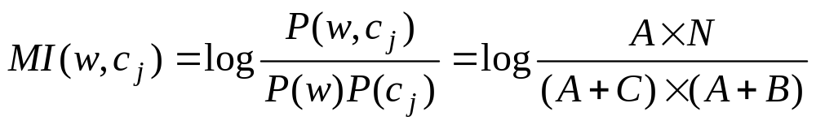


特征选择方法：互信息
Mutual Information (MI)：度量相关性
  A: w and C_{j} B: w and not C_{j}
  C: not w and C_{j} D: not w and not C_{j}
N = A + B + C + D

Slide 12
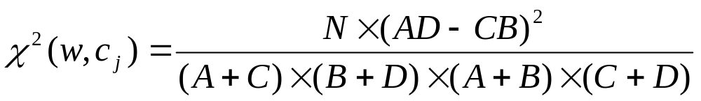
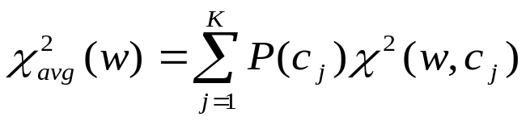
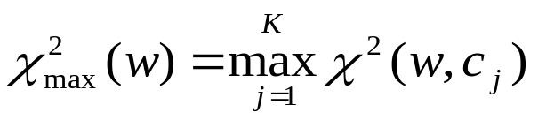
特征选择方法： χ^{2­} 统计量
χ^{2­} 统计量：度量独立性的缺乏
  A: w and C_{j} B: w and not C_{j}
  C: not w and C_{j} D: not w and not C_{j}
N = A + B + C + D

Slide 13
文档表示：向量空间模型
文档可以看作是经过特征选择后的项的向量，由于项的数目巨大，因此文档是高维空间中的一个点，每一维就是一个项t的权重w
权重一般用实数表示，如tf*idf值
高维空间可以进行降维操作
  SVD 矩阵的奇异值分解（如LSA采用）

Slide 14
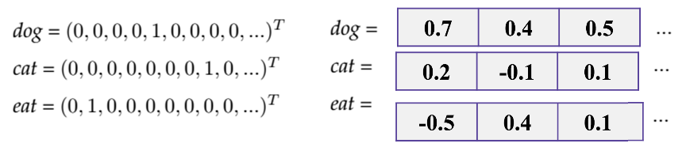
文档表示：向量空间模型（2）
把每个词看作一维没有利用词之间的语义关系：同义词语义相近！
1-hot vector vs. word embedding
word embedding: 低维稠密词向量
  Word2vec
  GloVe

Slide 15
文档表示：向量空间模型（3）
从词向量到文档向量
  Averaging （多个点到1个点）
    用tfidf加权
向量可以表示文档吗？
  保留子空间及其结构特征（创新之处！）

Slide 16



直觉
t₃
d₂
d₃
d₁
θ
φ
t₁
d₅
t₂
d₄
假设: 空间上接近的文档内容类似.

Slide 17
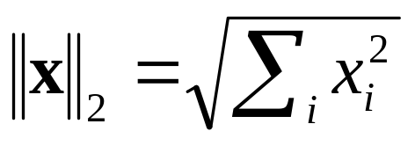
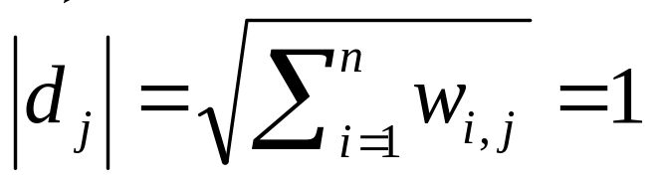
长度归一化
A vector can be normalized (given a length of 1) by dividing each of its components by its length – here we use the L₂ norm
This maps vectors onto the unit sphere:
Longer documents don’t get more weight

Slide 18
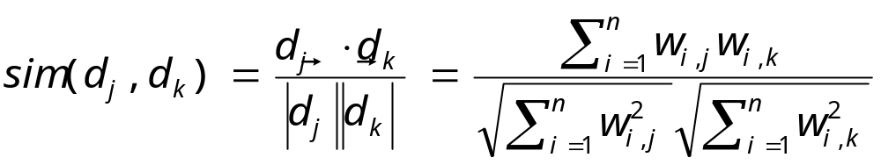
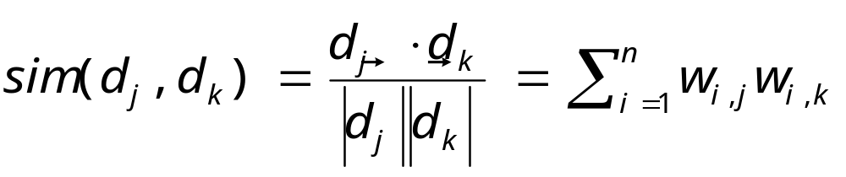
Cosine similarity
Cosine of angle between two vectors
分母归一化以后：
可以用来度量文档的相似度

Slide 19
文本分类评价
数据集=训练集+测试集。两者不交叉，但一般同分布。
分类准确率= c/n，n是待分类的所有文档数，c是正确分类的文档个数。
一致性：算法能正确分类所有的训练数据。
k折交叉验证：把数据集分成k份，任取1份作测试集，其他作训练集。把得到的k个准确率做平均。
学习曲线：随着数据集的增大，准确率的变化曲线。

Slide 20
文本分类算法
Rocchio’s algorithm
K-Nearest-Neighbor algorithm (KNN)
Decision Tree algorithm (DT)
Naive Bayes algorithm (NB)
Maximum Entropy Classifiers (maxent)
Support Vector Machine (SVM)
Ensemble Learning
Artificial Neural Network (ANN)

Slide 21
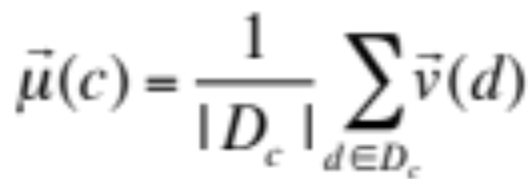
Rocchio算法
这个算法的思想和实现很简单。定义文档中心
D_{c} 是属于类c的所有文档的集合， v(d) 是文档d的向量空间表示.
文档中心是该类文档的“原型”（prototype）

Slide 22
Rocchio算法
分类：找出一个文档的最接近的原型向量。
该算法不一定对训练集是一致的。
很少用于实际系统，但是可用来作为一个baseline。

Slide 23
k Nearest Neighbor Classification
Sec.14.3
kNN = k Nearest Neighbor
To classify a document d:
  Define k-neighborhood as the k nearest neighbors of d
  Pick the majority class label in the k-neighborhood

Slide 24
Example: k=6 (6NN)
Sec.14.3
P(science| )?
Science
Sport
Art

Slide 25
Nearest-Neighbor Learning
Sec.14.3
Learning: just store the labeled training examples D
1NN is very similar to Rocchio. Testing instance x:
  Compute similarity between x and all examples in D.
  Assign x the category of the most similar example in D.
k is typically odd to avoid ties; 3 and 5 are most common
Also called:
  Case-based learning
  Memory-based learning

Slide 26
Nearest-Neighbor Learning
Sec.14.3
近朱者赤，近墨者黑
kNN gives locally defined decision boundaries between classes – far away points do not influence each classification decision
  like in SVM
  unlike in Naïve Bayes, Rocchio

Slide 27
kNN: Discussion
Sec.14.3
No feature selection necessary
No training necessary
Scales well with large number of classes
It is expensive when the training set is large
  It is difficult to find the optimal value of k

Slide 28
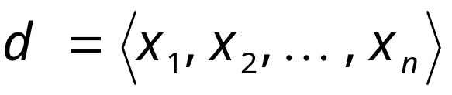
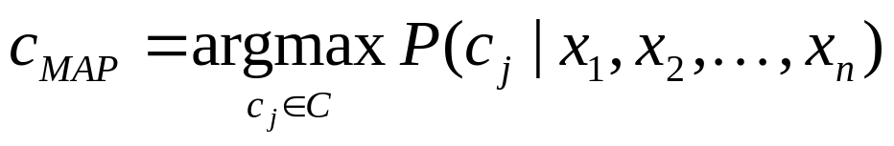
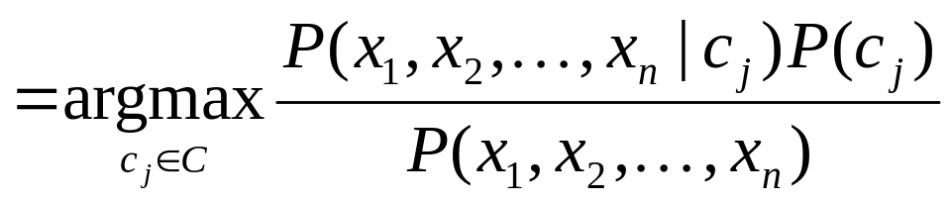
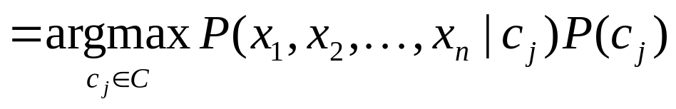
Naive Bayes Classifiers
Task: Classify a new document d based its features
into one of the classes c_{j} ∈ C
MAP: maximum a posteriori

Slide 29
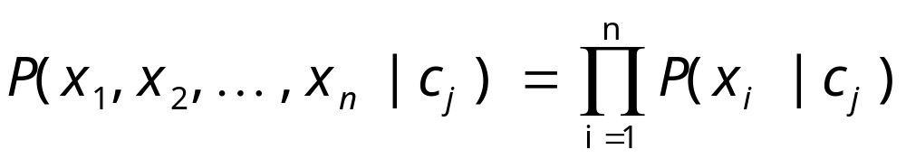
Naïve Bayes Classifier:
Naïve Bayes Assumption
P(c_{j})
  Can be estimated from the frequency of classes in the training examples.
P(x₁,x₂,…,x_{n}|c_{j})
Naïve Bayes Conditional Independence Assumption:
Assume that the probability of observing the conjunction of attributes is equal to the product of the individual probabilities P(x_{i}|c_{j}).

Slide 30
The Naïve Bayes Classifier
Flu
X₁
X₂
X₃
X₄
X₅
runnynose
sinus
cough
fever
muscle-ache
Conditional Independence Assumption: features are independent of each other given the class

Slide 31
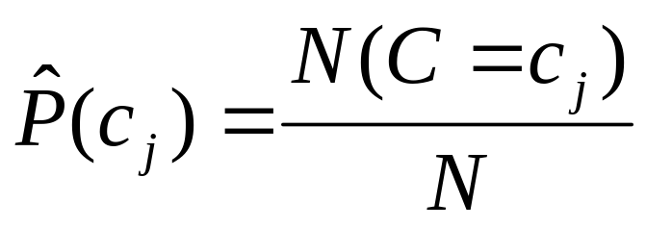
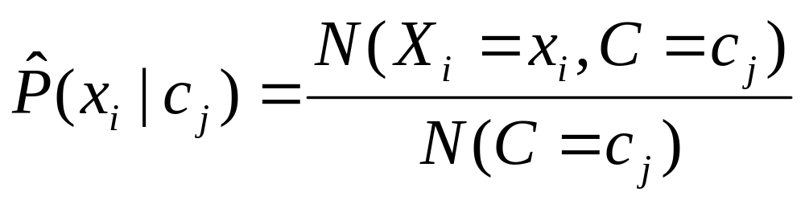
Learning the Model
C
X₁
X₂
X₃
X₄
X₅
X₆
First attempt: maximum likelihood estimates
  simply use the frequencies in the data

Slide 32
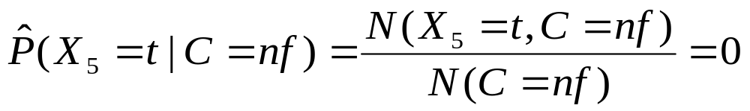
Problem with Max Likelihood
Flu
X₁
X₂
X₃
X₄
X₅
runnynose
sinus
cough
fever
muscle-ache
What if we have seen no training cases where patient had no flu and muscle aches?
0概率要进行处理!

Slide 33
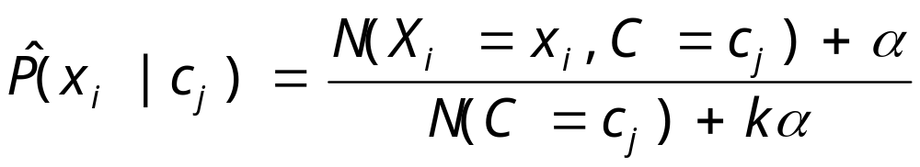
Smoothing to Avoid Overfitting
Laplace 平滑。当α=1，又称为加1平滑。常见的α还有0.5等
# of values of X_{i}

Slide 34
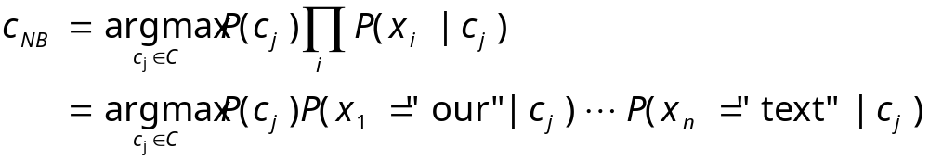
词袋模型
文档的特征就是词，而且我们不考虑词的相对顺序。相当于把词全部打乱放到一个袋子里，所以称“bag of words”，即词袋模型。

Slide 35
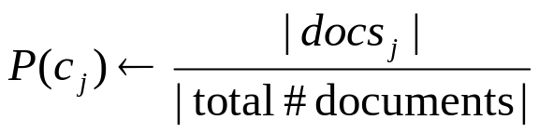
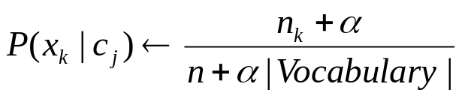
Naïve Bayes: Learning
From training corpus, extract Vocabulary
Calculate required P(c_{j}) and P(x_{k} | c_{j}) terms
  For each c_{j} in C do
    docs_{j} ← subset of documents for which the target class is c_{j}
    Text_{j} ← single document containing all docs_{j}
    for each word x_{k} in Vocabulary
      n_{k} ← number of occurrences of x_{k} in Text_{j}

Slide 36
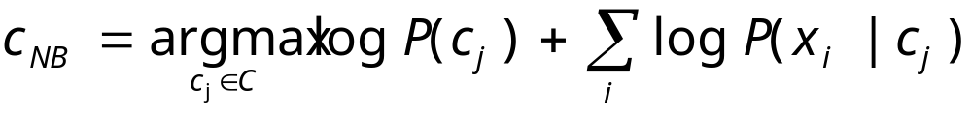
Underflow Prevention
Multiplying lots of probabilities, which are between 0 and 1 by definition, can result in floating-point underflow.
Since log(xy) = log(x) + log(y), it is better to perform all computations by summing logs of probabilities rather than multiplying probabilities.

Slide 37
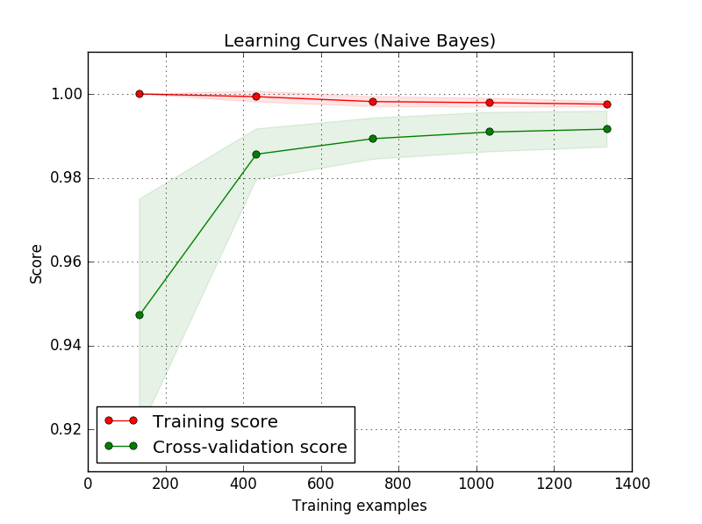
Sample Learning Curve

Slide 38
Naïve Bayes is Not So Naïve
Naïve Bayes: First and Second place in KDD-CUP 97 competition, among 16 (then) state of the art algorithms
  Goal: Financial services industry direct mail response prediction model: Predict if the recipient of mail will actually respond to the advertisement – 750,000 records.
Robust to Irrelevant Features
  Irrelevant Features cancel each other without affecting results
Very good in domains with many equally important features
A good dependable baseline for text classification (but not the best)!
Optimal if the Independence Assumptions hold: If assumed independence is correct, then it is the Bayes Optimal Classifier for problem
Very Fast: Learning with one pass over the data; testing linear in the number of attributes, and document collection size
Low Storage requirements

Slide 39
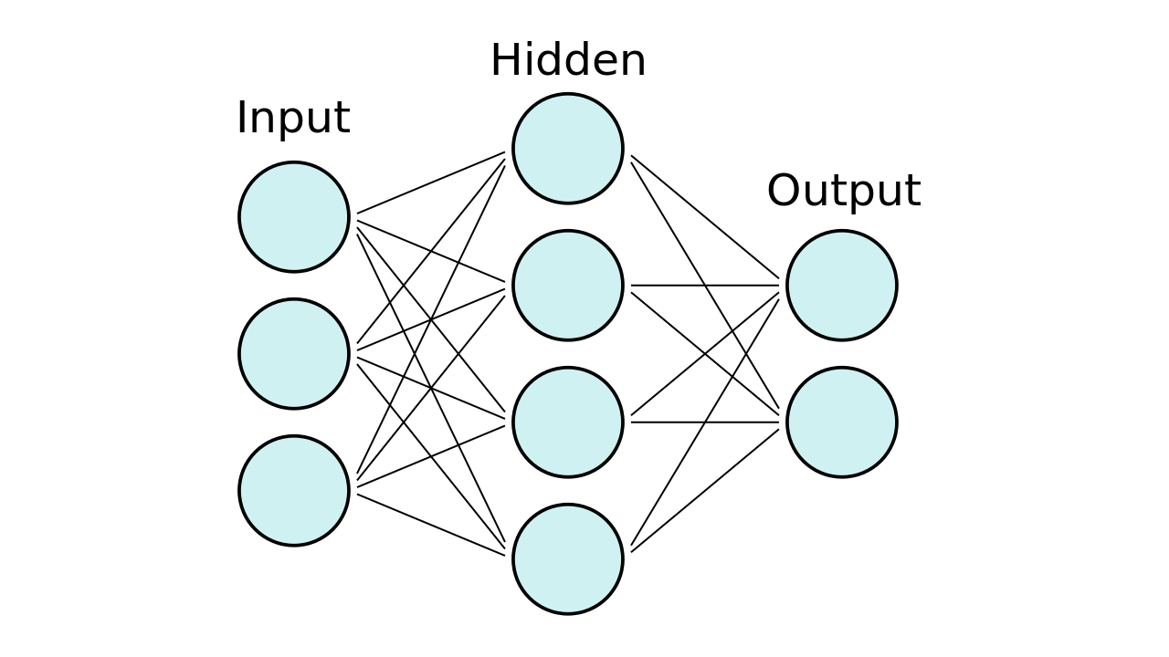
用神经网络来做文本分类

Slide 40

用神经网络来做文本分类
输入到输出的变换：激活函数
  Sigmoid/ReLu/Softmax/GeLu…
权重训练：backpropogation
优化方法：loss函数+梯度下降
优化技巧：adam/dropout/…

Slide 41
用神经网络来做文本分类
相关python工具
  Pytorch
  Keras
用Keras构建神经网络分类模型
  下载数据集
    Sentiment Labelled Sentences Data Set https://archive.ics.uci.edu/ml/datasets/Sentiment+Labelled+Sentences

Slide 42
用神经网络来做文本分类
import pandas as pd
filepath_dict = {'yelp': 'data/sentiment_analysis/yelp_labelled.txt',
'amazon': 'data/sentiment_analysis/amazon_cells_labelled.txt',
'imdb': 'data/sentiment_analysis/imdb_labelled.txt'}
df_list = []
for source, filepath in filepath_dict.items():
df = pd.read_csv(filepath, names=['sentence', 'label'], sep='\t')
df['source'] = source # Add another column filled with the source name
df_list.append(df)
df = pd.concat(df_list)

Slide 43
用神经网络来做文本分类
>>> df_list[0]
sentence label source
0 Wow... Loved this place. 1 yelp
1 Crust is not good. 0 yelp
2 Not tasty and the texture was just nasty. 0 yelp
3 Stopped by during the late May bank holiday of... 1 yelp
4 The selection on the menu was great and so wer... 1 yelp
.. ... ... ...
995 I think food should have flavor and texture an... 0 yelp
996 Appetite instantly gone. 0 yelp
997 Overall I was not impressed and would not go b... 0 yelp
998 The whole experience was underwhelming, and I ... 0 yelp
999 Then, as if I hadn't wasted enough of my life ... 0 yelp
[1000 rows x 3 columns]

Slide 44
用神经网络来做文本分类
选出yelp子集
>>> from sklearn.model_selection import train_test_split
>>> df_yelp = df[df['source'] == 'yelp']
提取句子与标签，并划分为训练集、测试集
>>> sentences = df_yelp['sentence'].values
>>> y = df_yelp['label'].values
>>> sentences_train, sentences_test, y_train, y_test = train_test_split(
... sentences, y, test_size=0.25, random_state=1000)

Slide 45
用神经网络来做文本分类
转换成向量
>>> from sklearn.feature_extraction.text import CountVectorizer
>>> vectorizer = CountVectorizer()
>>> vectorizer.fit(sentences_train)
>>> X_train = vectorizer.transform(sentences_train)
>>> X_test = vectorizer.transform(sentences_test)

Slide 46
用神经网络来做文本分类
用Keras构建网络模型
  >>> from keras.models import Sequential
  >>> from keras import layers
  >>> input_dim = X_train.shape[1] # Number of features
  >>> model = Sequential()
  >>> model.add(layers.Dense(10, input_dim=input_dim, activation='relu'))
  >>> model.add(layers.Dense(1, activation='sigmoid'))
  >>> model.compile(loss='binary_crossentropy', optimizer='adam', metrics=['accuracy'])

Slide 47
用神经网络来做文本分类
用Keras进行模型训练与测试
  >>> history = model.fit(X_train, y_train,
  ... epochs=100,
  ... verbose=False,
  ... validation_data=(X_test, y_test)
  ... batch_size=10)
  >>> loss, accuracy = model.evaluate(X_train, y_train, verbose=False)
  >>> print("Training Accuracy: {:.4f}".format(accuracy))
  >>> loss, accuracy = model.evaluate(X_test, y_test, verbose=False)
  >>> print("Testing Accuracy: {:.4f}".format(accuracy))
Training Accuracy: 1.0000
Testing Accuracy: 0.7960

Slide 48
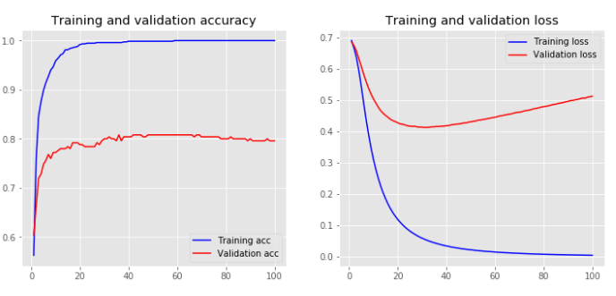
用神经网络来做文本分类
效果可视化
  import matplotlib.pyplot as plt
  plt.style.use('ggplot')
  def plot_history(history):
  acc = history.history['acc']
  val_acc = history.history['val_acc']
  loss = history.history['loss']
  val_loss = history.history['val_loss']
  x = range(1, len(acc) + 1)
  plt.figure(figsize=(12, 5))
  plt.subplot(1, 2, 1)
  plt.plot(x, acc, 'b', label='Training acc')
  plt.plot(x, val_acc, 'r', label='Validation acc')
  plt.title('Training and validation accuracy')
  plt.legend()
  plt.subplot(1, 2, 2)
  plt.plot(x, loss, 'b', label='Training loss')
  plt.plot(x, val_loss, 'r', label='Validation loss')
  plt.title('Training and validation loss')
  plt.legend()
>>> plot_history(history)

Slide 49
用其他机器学习算法来分类
逻辑回归（Logistic Regression）是一种常见的分类算法
  from sklearn.linear_model import LogisticRegression
  classifier = LogisticRegression()
  classifier.fit(X_train, y_train)
  score = classifier.score(X_test, y_test)

Slide 50
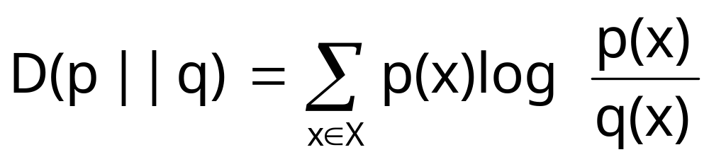
Kullback-Leibler Divergence
Relative entropy or KL (Kullback-Leibler) divergence
用于度量2个概率分布之间的差异。但是KL是非对称的！
也可用于文本分类
  我的简繁体识别程序

Slide 51
作业
写一个程序，能对任意一个汉语文本文件，指出是简体还是繁体。
（阅读）Keras文本分类： https://realpython.com/python-keras-text-classification/

Slide 52
project
文本规范化程序（可多人合作）：在网络上，表达一个概念通常有多种方法，尤其是很多故意采用错别字的写法。比如有人用“虎纠”表示“福州”，“灰机”表示“飞机”，“P民”表示“屁民”。文本规范化是指把一段非正规的文本（包括火星文）变换成规范化的文本的过程。请写这样一个程序。要求：输入：任意一段文本；输出：规范化以后的文本。直接用文件名来表示输入输出即可。

